Slide 1
How to improve English through reading literature
Yatsenko Irina

Slide 2
Learning to read
PISA
Internet influence
Final exams
Reading for pleasure???

Slide 3
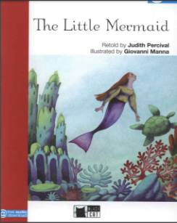
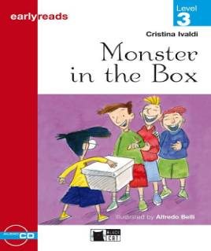
Primary school Reading fiction
Reading for pleasure
3-4 Grades
Book selection
Reading strategies
Book review

Slide 4
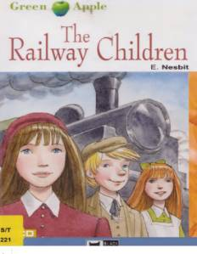
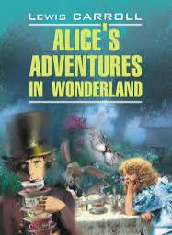
Secondary school Reading fiction
Reading marathon 6 grade
Elective course “Reading for pleasure” 7 grade

Slide 5
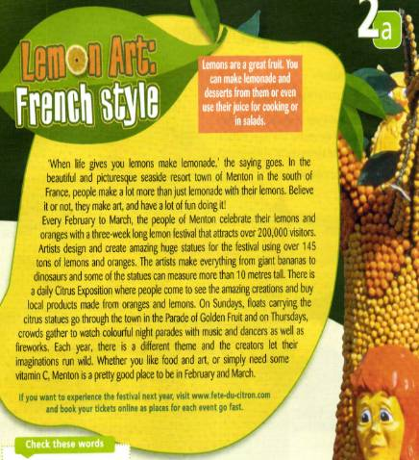
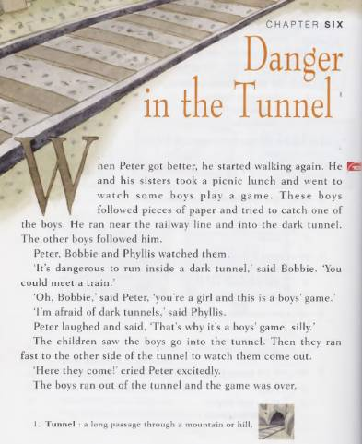
Read and compare

Slide 6
Are there any differences?
Fiction
Non-fiction
Story talk
Factual
Read to enjoy
Read to learn
Read in order
Can be read in any order
Illustrations
Photos, charts…
Beginning, middle and end
Glossary, words in bold…
Setting
Problem and solution
Emotions

Slide 7
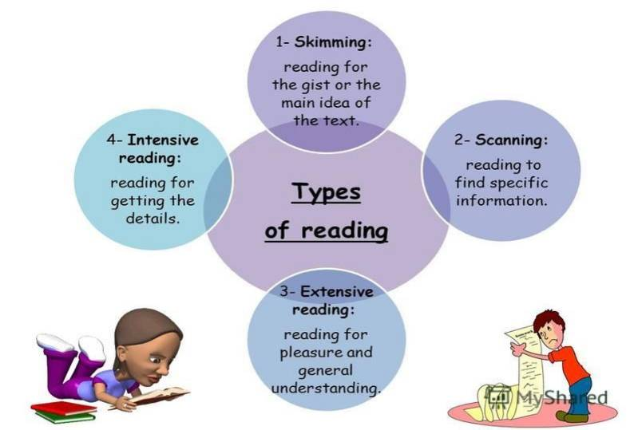

Slide 8
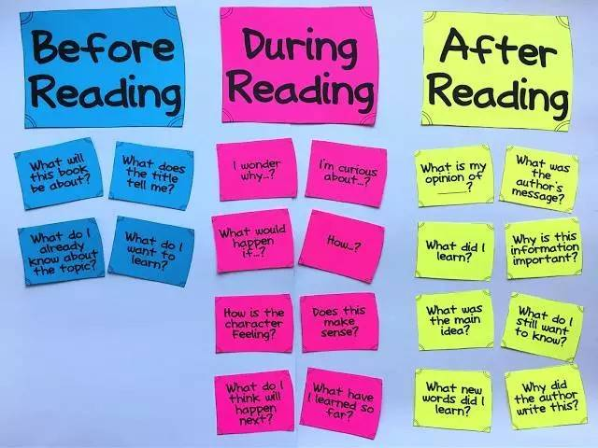

Slide 9
While-reading tasks
Choosing true or false
Multiple choice
Answering the questions
Completing the sentences
Sequencing events
Matching the headings with the paragraphs

Slide 10
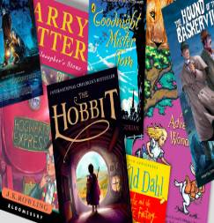
While-reading tasks
Making character sketches
Using graphic organisers
Get it wrong
Choosing the most appropriate summary
Chapter and verse
Story map
Give the evidence
Dear diary
Expanding
Picking up key sentences from the story….

Slide 11
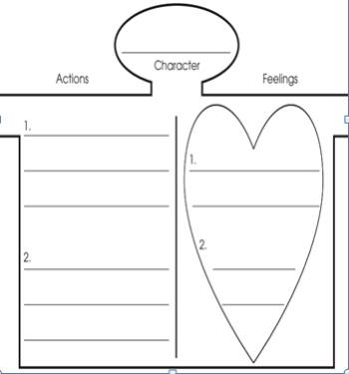
The Railway children : chapter 6 Danger in the tunnel
Task 1. Characters
Choose a character from a chapter and write his or her name on the head. Describe some things the character did and his/her related feelings.

Slide 12
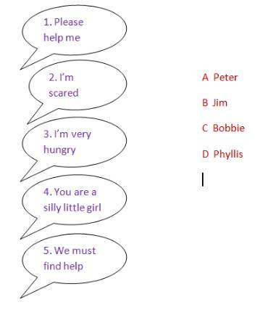
The Railway children : chapter 6 Danger in the tunnel
Task 2. Characters
Match each sentence with a person. You can use each character more than once.

Slide 13
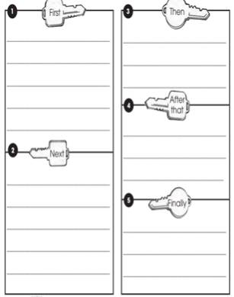
The Railway children : chapter 6 Danger in the tunnel
Task 3. Key events
Write the important events of the chapter in the boxes. Use the sequence words to put the events in order.

Slide 14
The Railway children : chapter 6 Danger in the tunnel
Task 4. Pair work
Divide the chapter into the parts. Think about the titles. Add 5 sentences to each part/find these words in the chapter and make written notes about each one.
Chapter 6
???l
5 sentences
5 sentences
Walk near the tunnel
A picnic lunch- a boy’s game- six boys- one boy inside

Slide 15
The Railway children : chapter 6 Danger in the tunnel
Task 5. Speaking
Be ready to retell the part of the chapter.

Slide 16
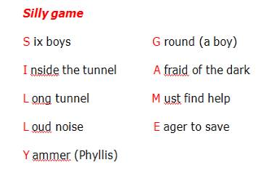
The Railway children : chapter 6 Danger in the tunnel
Extra task. “Chapter and verse”
Write associated ideas horizontally alongside the suggested chapter’s title. The new title serves as a mini-summary of the chapter.

Slide 18
The importance of reading
Books can stimulate imagination and play
Books provoke curiosity and discussion
Books provide inspiration, thought and reflection
Reading of variety of books exposes students to a wide range of language features and vocabulary

Slide 19
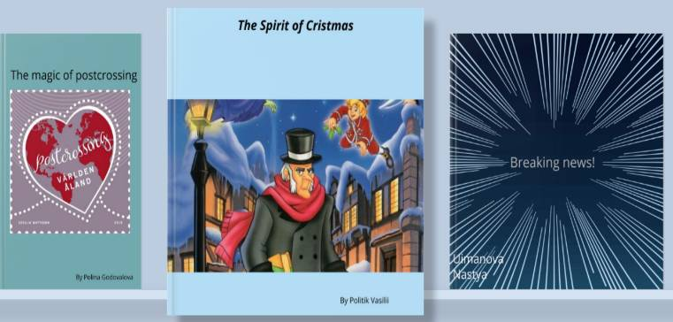
https://bookcreator.com/

